Slide 1

Helmet Cooling Using Peltier Module

Slide 2
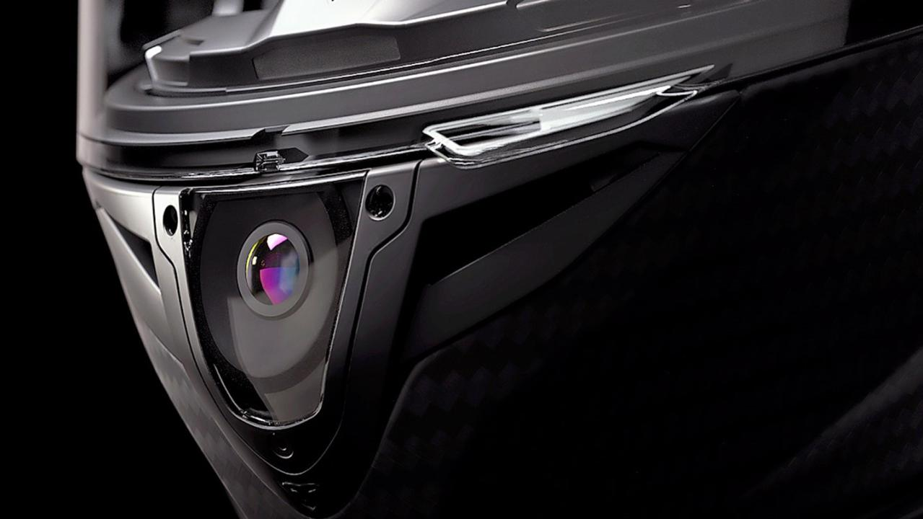

Presented By:
Roll No Name of Students PRN
44 Bonde Rushikesh Pandharinath 211203006
48 Chavan Jay Jitesh 211203010
51 Khadase Akshay Sopan 211203013
Guided By:
Project Guide
Prof. P. V. Baviskar
Project coordinator
Prof. P. K. Patil
Department of Mechanical Engineering
R. C. Patel Institute of Technology,
Shirpur-425405
2023-2024

Slide 3

INDEX
Introduction
Objectives
Components
  Helmet
  Heat Sink
  Axial Fan
  Thermometer
  Peltier Module
Implementation
Final Model
Experimental analysis and reading
Necessity
Advantages
Conclusion

Slide 4
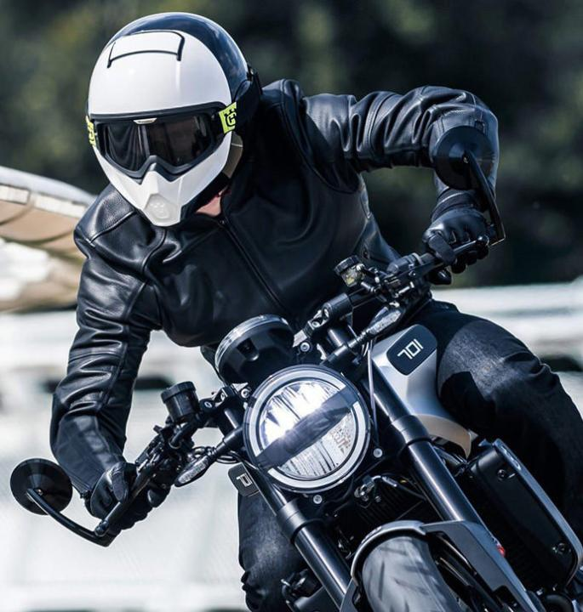
Introduction
Helmets are an essential piece of safety gear for many activities, such as riding a motorcycle, riding a bicycle, or playing sports.
However, helmets can also make the wearer feel hot and uncomfortable, especially in hot weather.
This presentation will discuss a method for cooling helmets using Peltier modules.

Slide 5
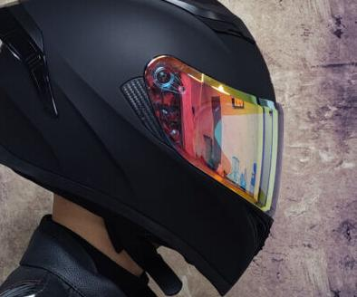
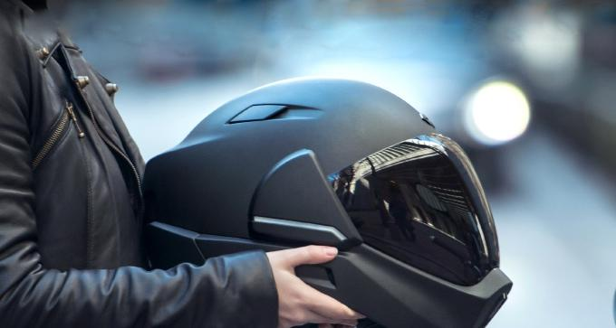
A cooling helmet can be made by placing a Peltier module in a helmet with a cooling fan.
The Peltier module will cool the air inside the helmet, and the cooling fan will blow the cool air over the wearer's head.

Slide 6
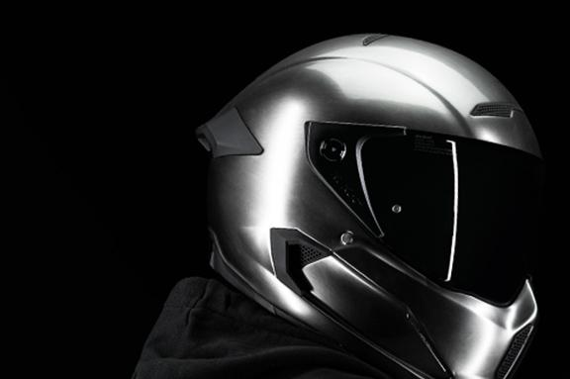
Objectives
Temperature Regulation
Heat Dissipation
Thermal Comfort
Safety
Fit and Adjustability
Adaptability

Slide 7
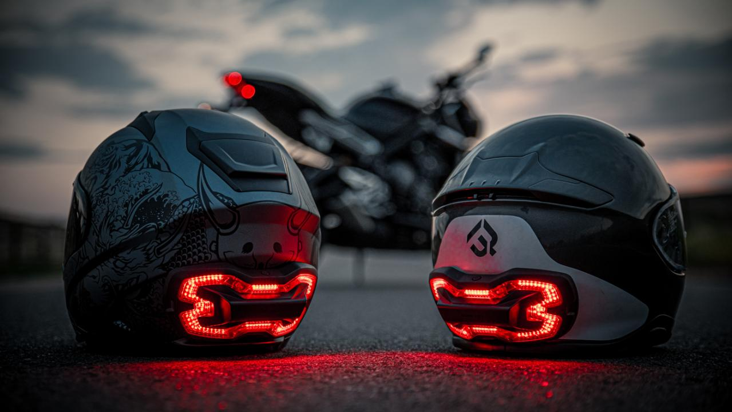
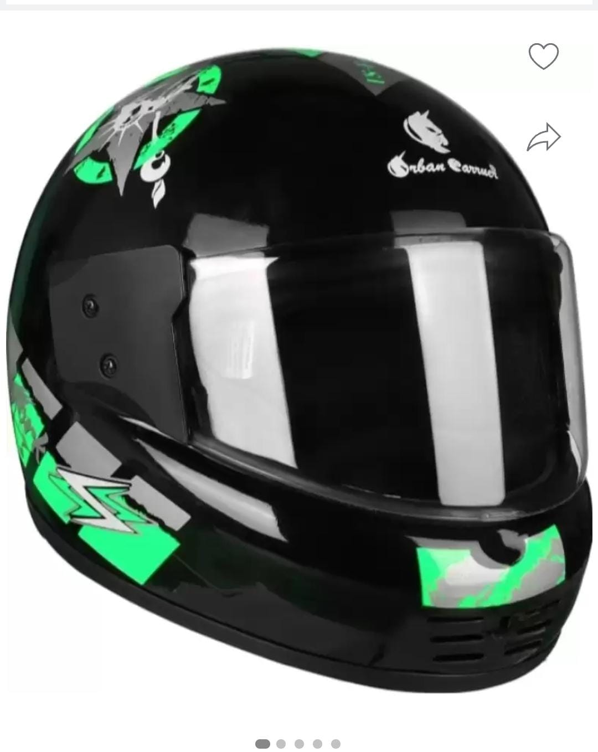
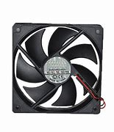

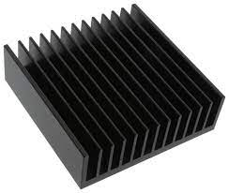
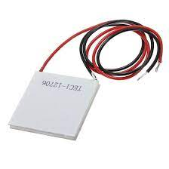
Components
Thermoelectric module
Heat Sink
Helmet
Fan
Thermometer
Helmet

Slide 8
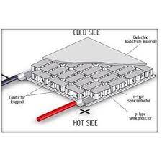
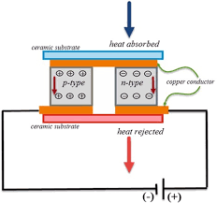
Peltier Module
Peltier module (thermoelectric module) is a thermal control module that has both "warming" and "cooling" effects.
By passing an electric current through the module, it is possible to change the surface temperature and keep it at the target temperature.
A voltage is applied across joined conductors to create an electric current.
When the current flows through the junctions of the two conductors, heat is removed at one junction and cooling occurs. Heat is deposited at the other junction. The main application of the Peltier effect is cooling.

Slide 9
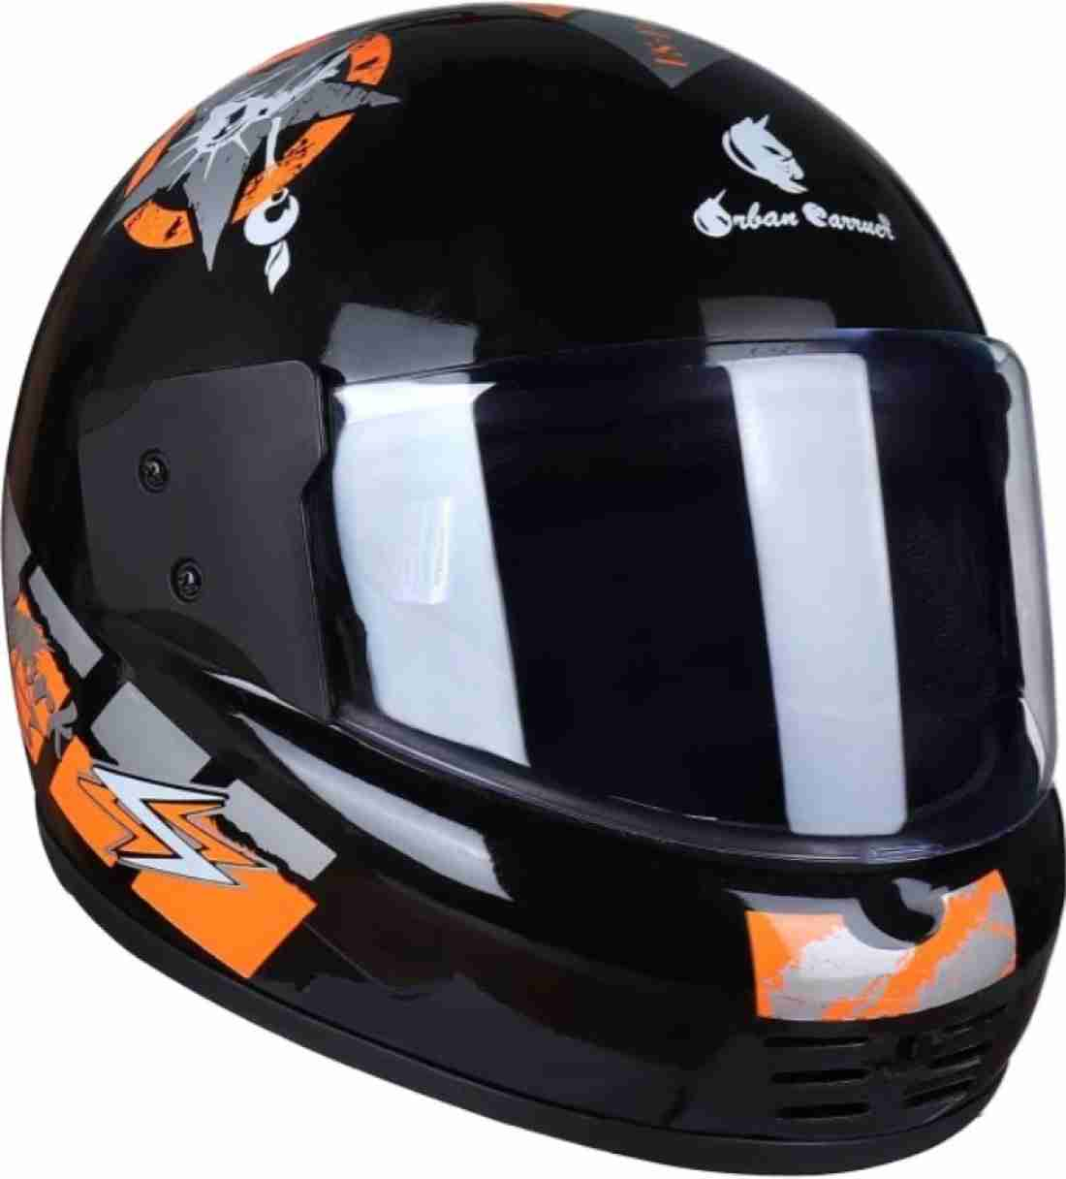
Helmet
A helmet is a form of protective gear worn to protect the head. More specifically, a helmet complements the skill in protecting the human brain.
It is typically made of a hard outer shell, such as polycarbonate or ABS plastic, and an inner liner of expanded polystyrene (EPS) foam. The EPS foam is designed to absorb the force of an impact and help to prevent skull fractures and brain injuries.

Slide 10
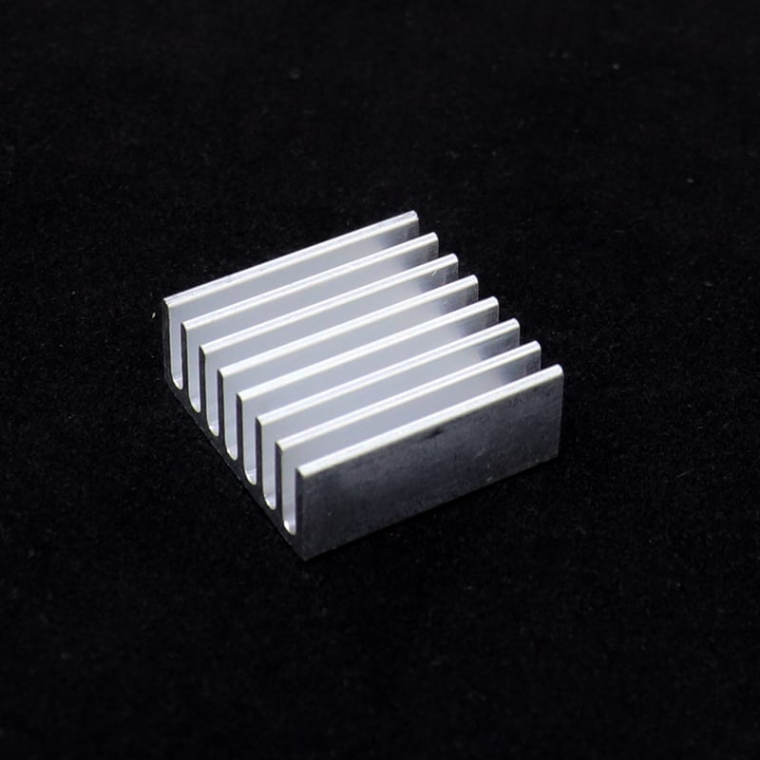
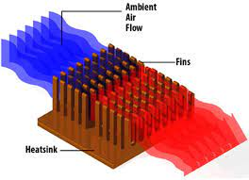
Heat Sink
A heat sink is a component that increases the heat flow away from a hot device. A heat sink is a passive heat exchanger that transfers the heat generated by an electronic or a mechanical device to a fluid medium, often air or a liquid coolant, where it is dissipated away from the device, thereby allowing regulation of the device’s temperature.
Passive heat sinks are 100 % reliable, as they have no mechanical components. Passive heat sinks are made of an aluminum finned radiator that dissipates heat through convection.
Heat sinks are used to cool CPUs, GPUs, and some chipsets and RAM modules in computers.

Slide 11
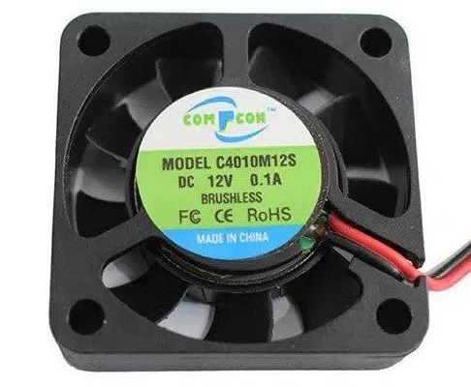
Fan
It is a 12V DC fan with 0.15A. It has two wires (positive and negative) with connector to connect with the source. It is used for cooling operations in computer devices.
Specification:
Material: Plastic
Current: 0.15A
Voltage: DC 12V

Slide 12
Thermometer
A digital thermometer is used to verify a smart temperature transmitter under flowing conditions and a successful calibration of the smart temperature transmitter. Portable electronic thermometers (PETs) are designed to measure temperature in a RTD-type thermowell using a thermistor or RTD probe.
Thermoelectric modules are solid state devices that convert an electric current into a temperature gradient. They operate on the principle of the Peltier effect. They consist of two sides – a hot side and a cold side. These are also known as Peltier device, Peltier heat pump, Solid state refrigerator, or thermoelectric cooler.

Slide 13
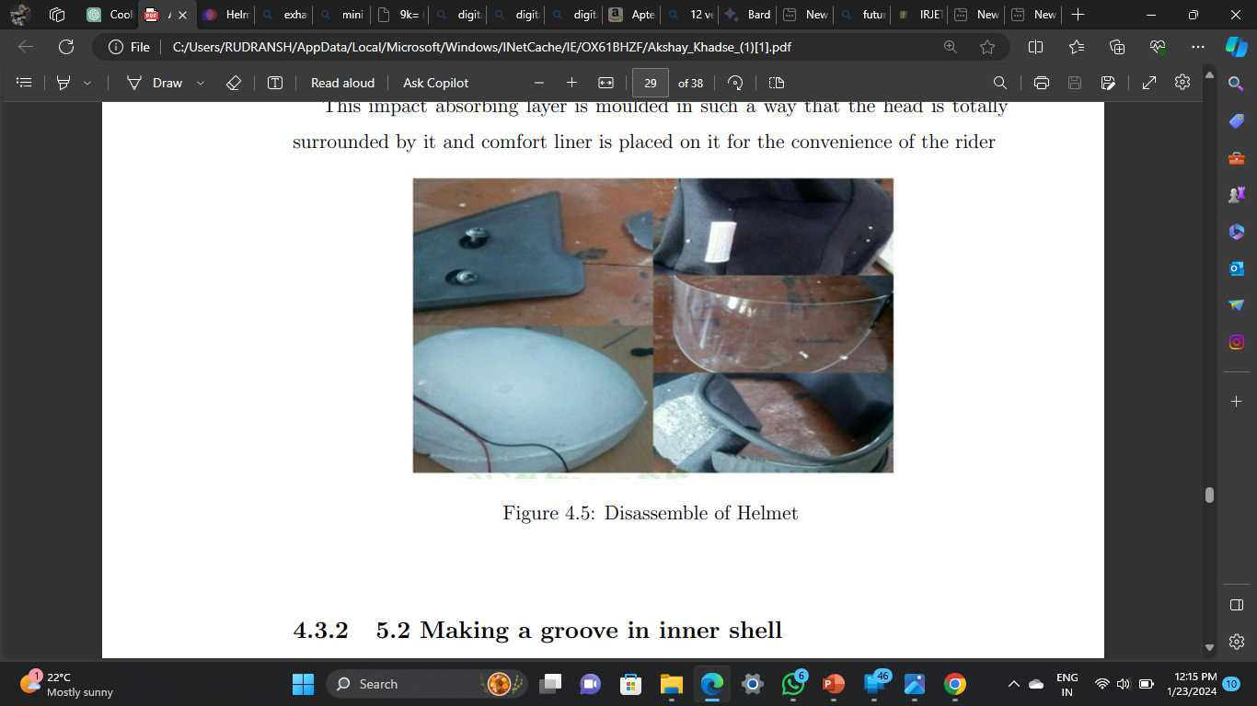
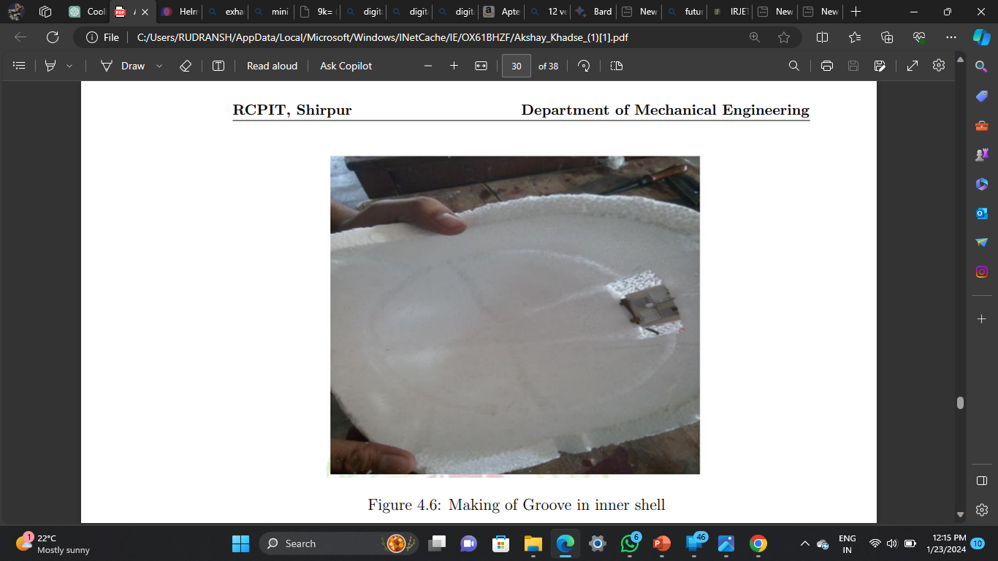
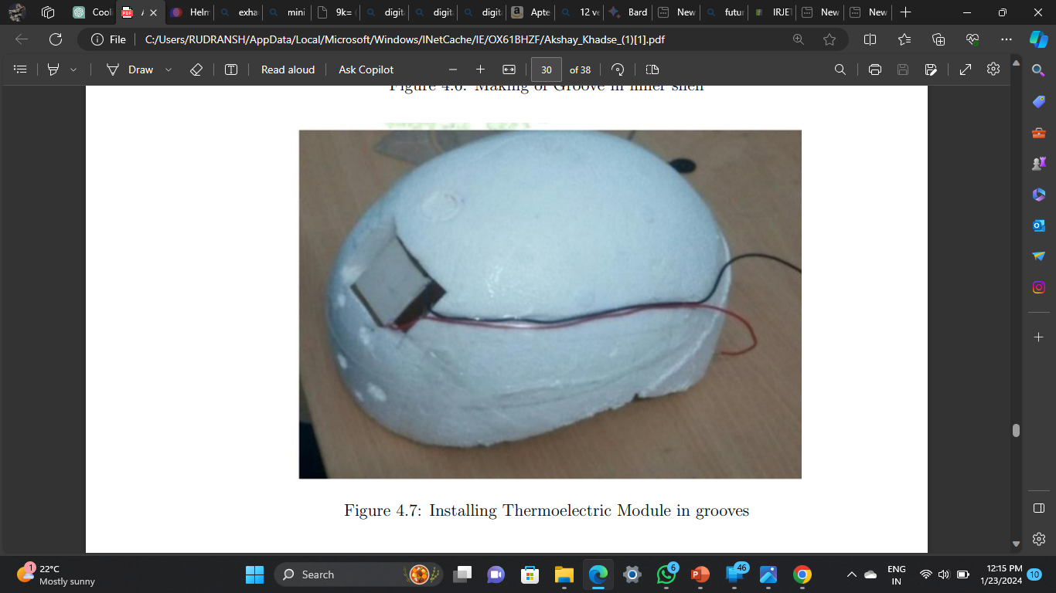
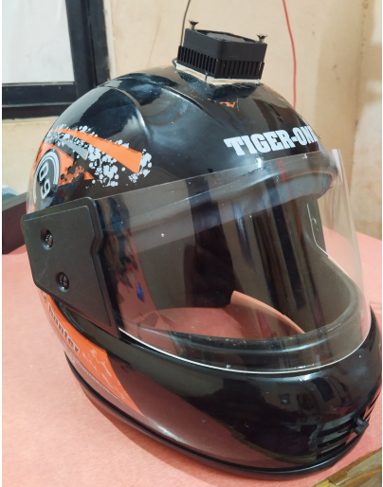
Implementation
Disassembling the Helmet
Making a groove in inner shell
Installing Thermoelectric Module
Assemble of helmet

Slide 14
Final Model

Slide 15
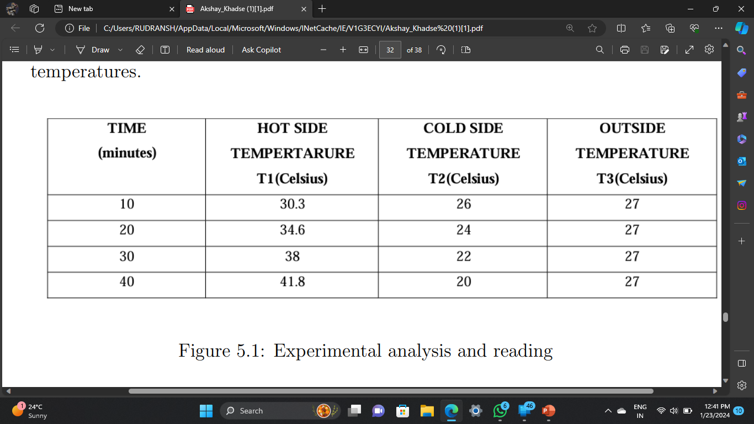
Experimental analysis and reading

Slide 16
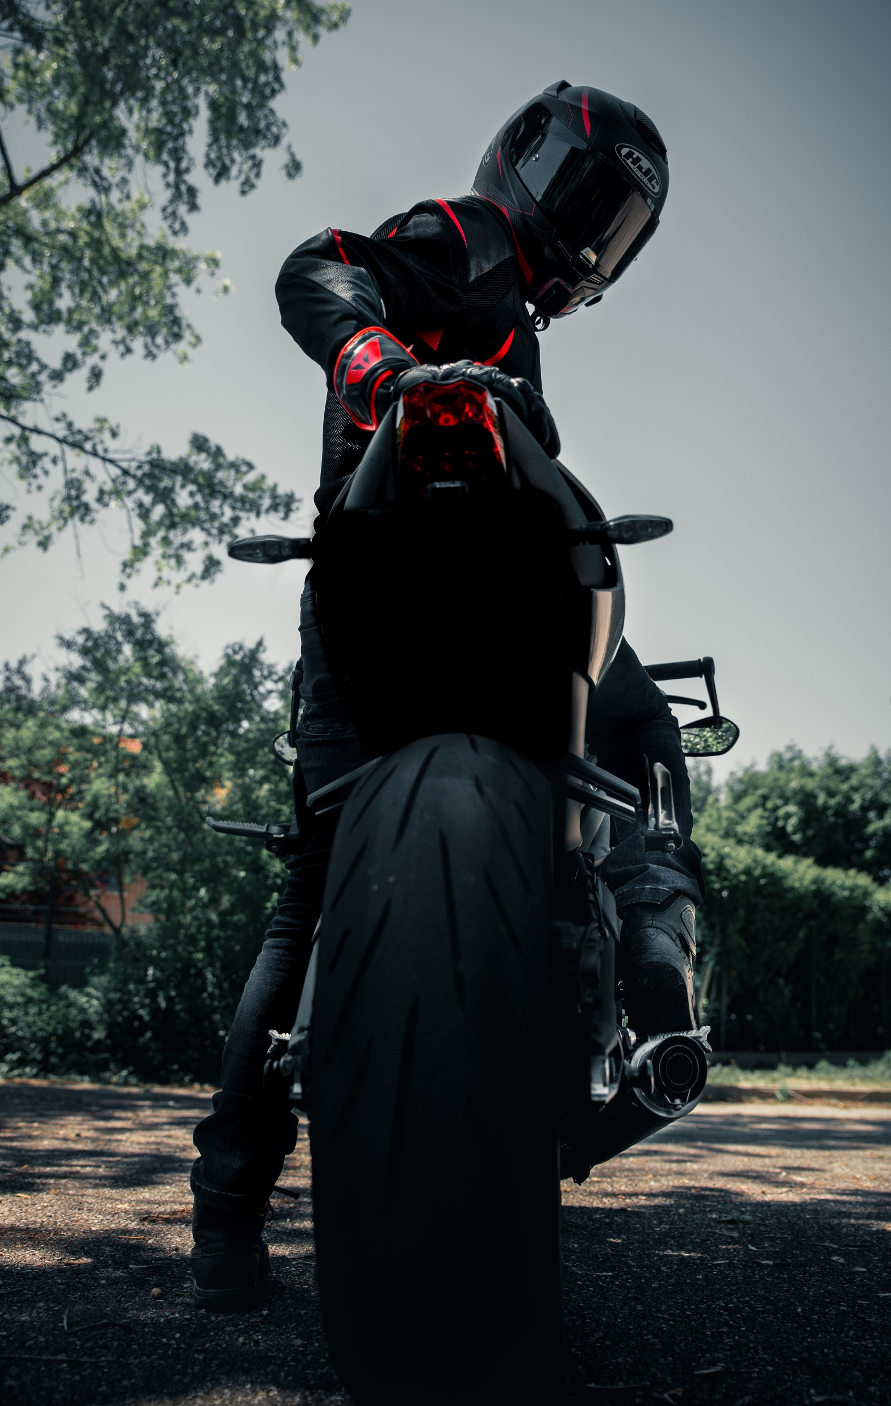

Necessity
Preventing Overheating: Riding a bike, especially in warm weather, can lead to the accumulation of heat inside the helmet. A cooling helmet helps dissipate this heat, preventing discomfort and reducing the risk of heat-related issues such as heat exhaustion or heatstroke.
Enhanced Comfort:
  Temperature Regulation: Cooling helmets provide a more comfortable riding experience by regulating the temperature within the helmet. This is particularly important during long rides or in hot and humid conditions.
Safety Considerations:
  Preventing Fogging: In cooler weather, helmets may fog up due to the temperature difference inside and outside the helmet. Cooling systems can help prevent fogging, ensuring clear visibility for the rider.
Customized Cooling:
  Adjustable Cooling Settings: Some cooling helmets allow riders to customize the cooling level based on their preferences or the prevailing weather conditions, providing a personalized and adaptable solution.

Slide 17
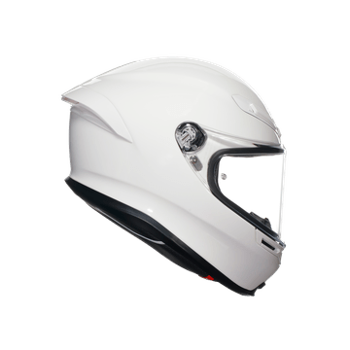
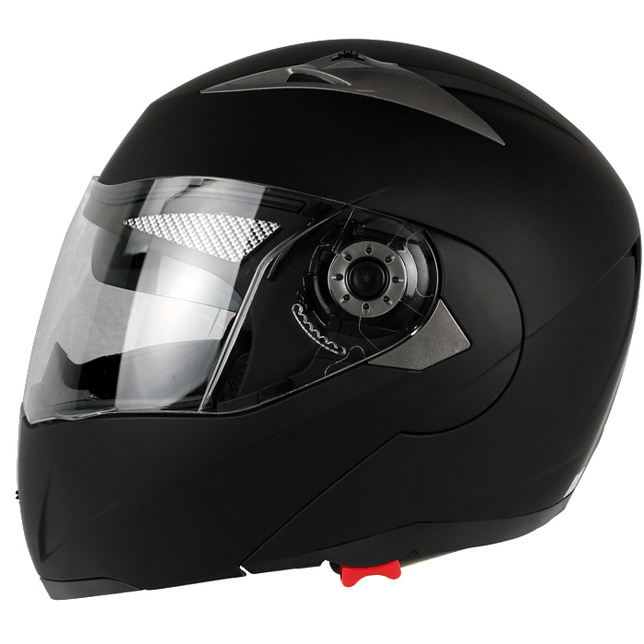
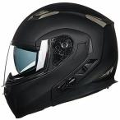
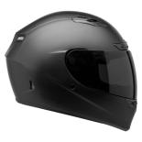
Advantages of Peltier Cooling Helmets
Peltier cooling helmets are a comfortable and effective way to keep the wearer cool.
They are also lightweight and portable, making them ideal for use in a variety of activities.
Peltier cooling helmets can help to reduce the risk of accidents and improve safety.
Peltier cooling helmets can help to reduce fatigue and improve cognitive performance.

Slide 18
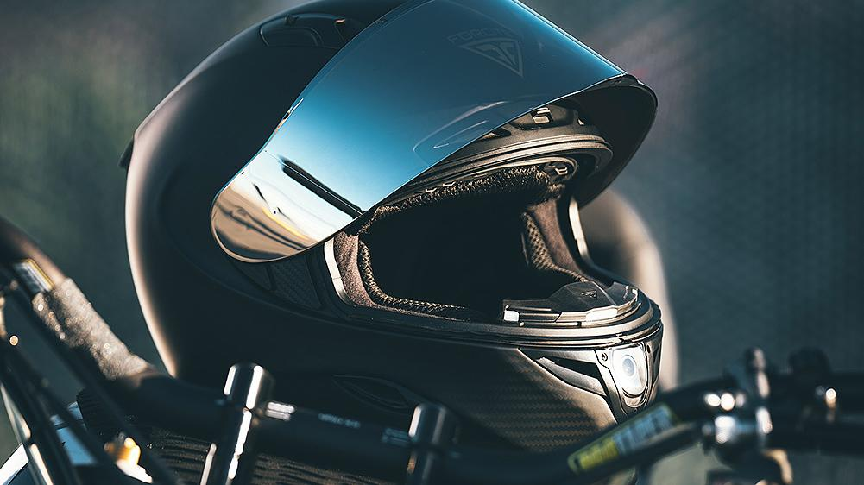
Peltier cooling helmets are a promising new technology that can help to keep the wearer cool and comfortable.
They are still in the early stages of development, but they have the potential to revolutionize the way we think about helmet safety.
Conclusion

Slide 19
Thank You!

